Slide 1
Pizza Sales Analysis Using MySQL
Presented By Sanskar Choudhari

Slide 2
ABOUT PROJECT
This project focuses on analyzing a pizza sales dataset using MySQL to extract meaningful business insights and support data-driven decision-making. The goal was to explore sales patterns, product performance, and customer behavior through SQL queries ranging from basic aggregations to advanced analytics.
The analysis was conducted in MySQL, and all results, including SQL query screenshots and visual summaries, have been compiled into this presentation to demonstrate technical proficiency and real-world data application.

Slide 3
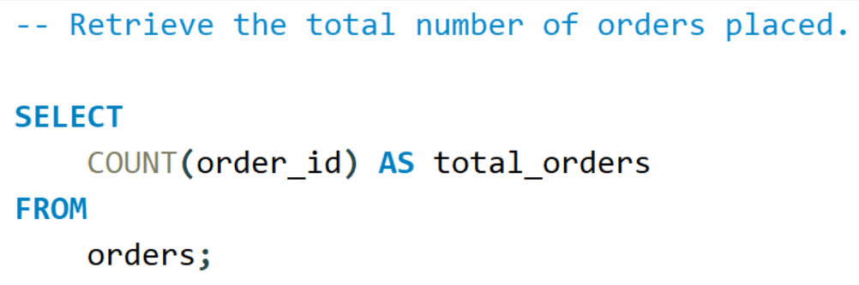
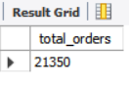
Retrieve the total number of orders placed.
Query
Solution

Slide 4
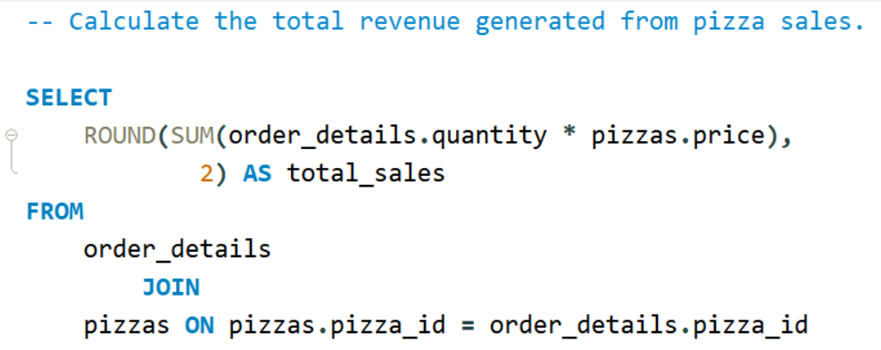
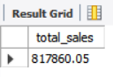
Calculate the total revenue generated from pizza sales.

Slide 5
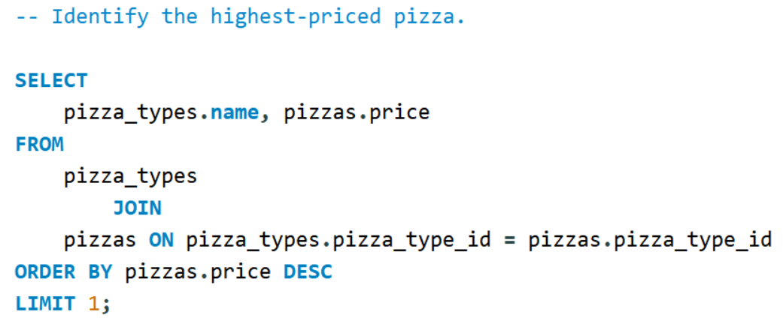
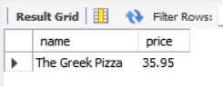
Identify the highest-priced pizza.

Slide 6
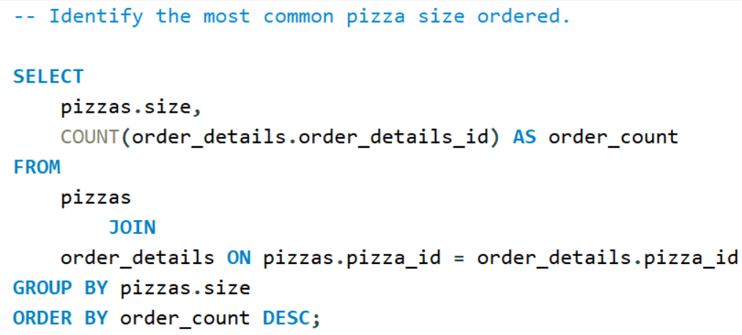
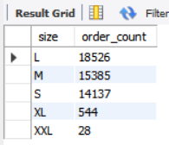
Identify the most common pizza size ordered.

Slide 7
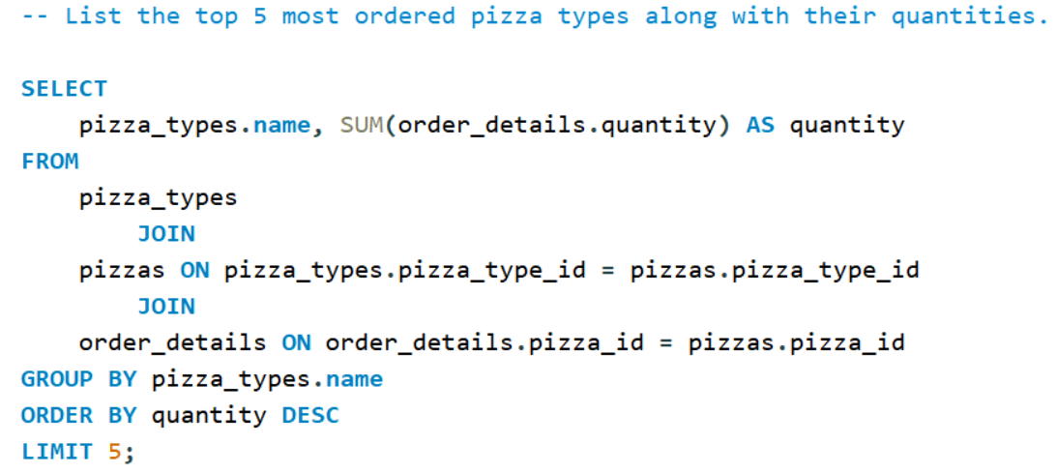
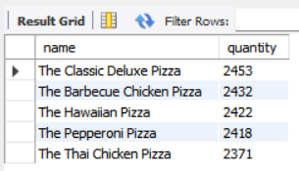
List the top 5 most ordered pizza types along with their quantities.

Slide 8
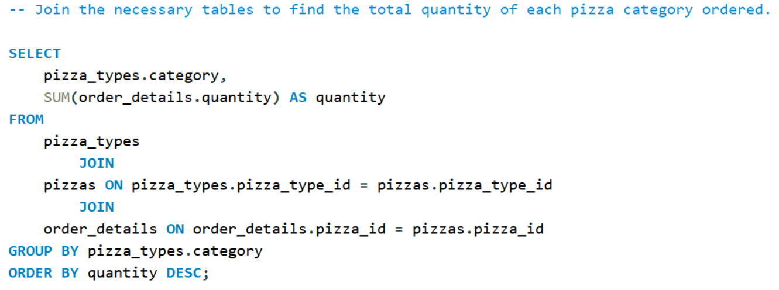
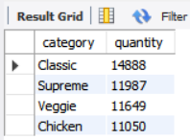
Join the necessary tables to find the total quantity of each pizza category ordered.

Slide 9
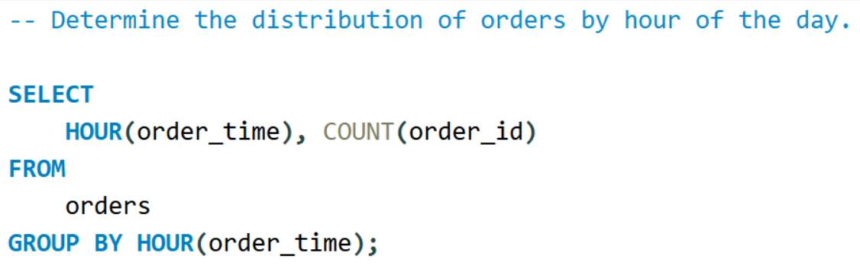
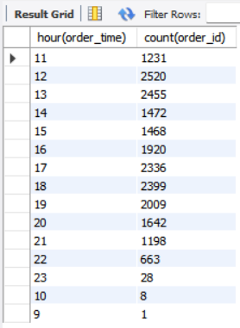
Determine the distribution of orders by hour of the day.

Slide 10
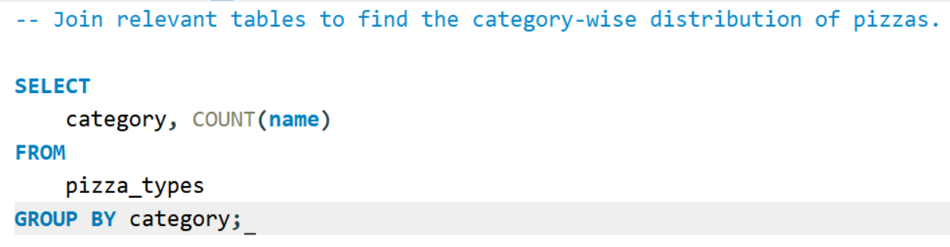
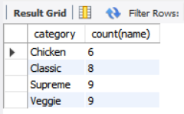
Join relevant tables to find the category-wise distribution of pizzas.

Slide 11
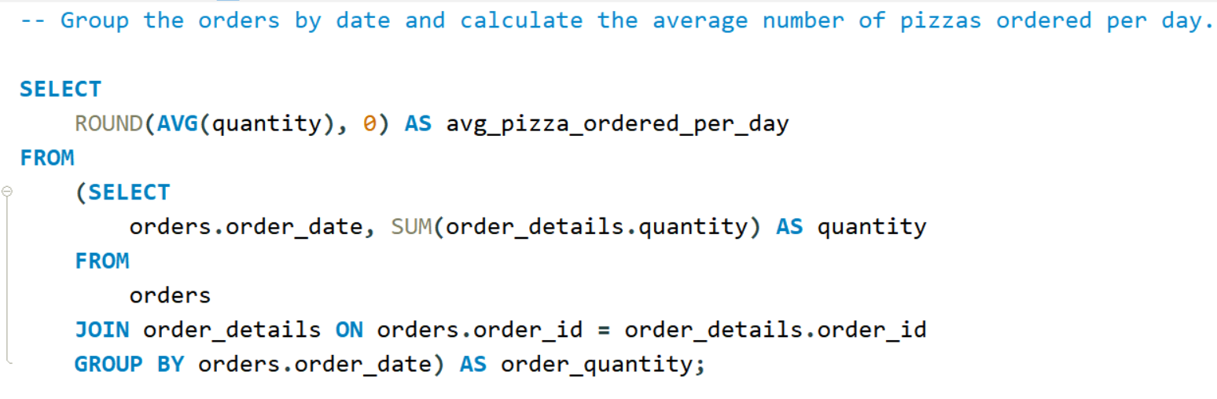
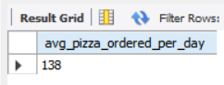
Group the orders by date and calculate the average number of pizzas ordered per day.

Slide 12
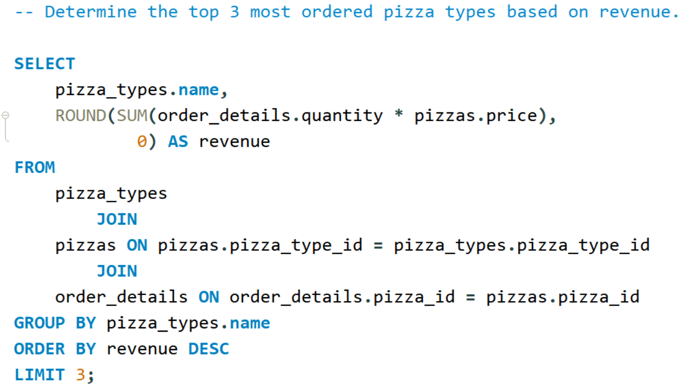
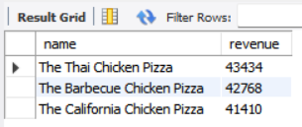
Determine the top 3 most ordered pizza types based on revenue.

Slide 13
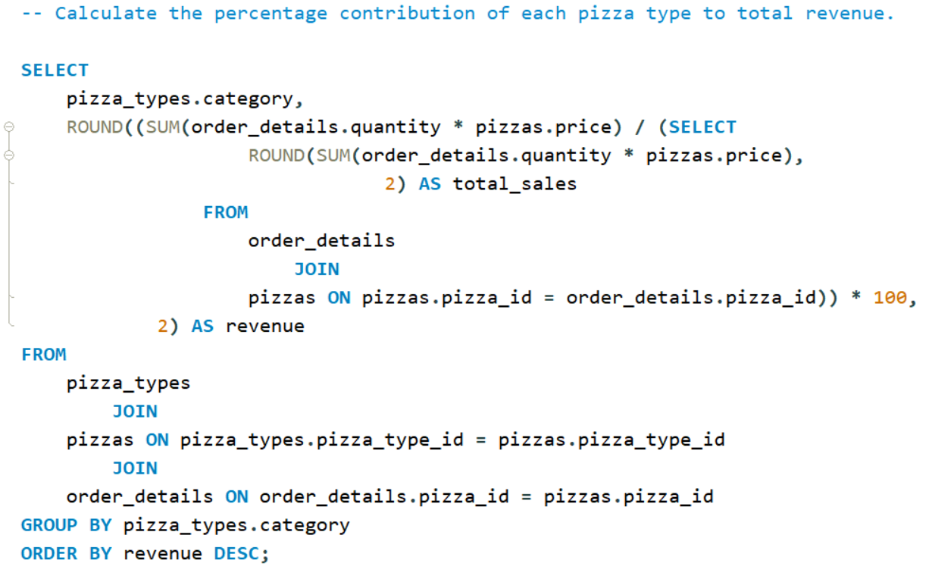
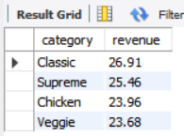
Calculate the percentage contribution of each pizza type to total revenue.

Slide 14
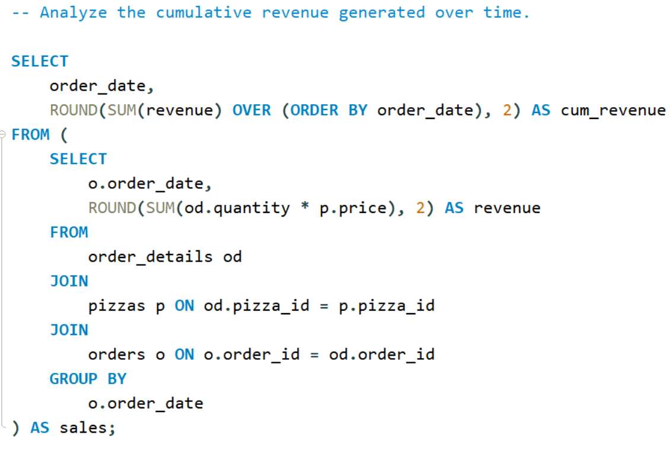
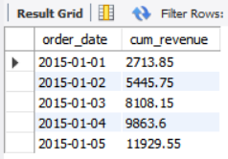
Analyze the cumulative revenue generated over time.

Slide 15
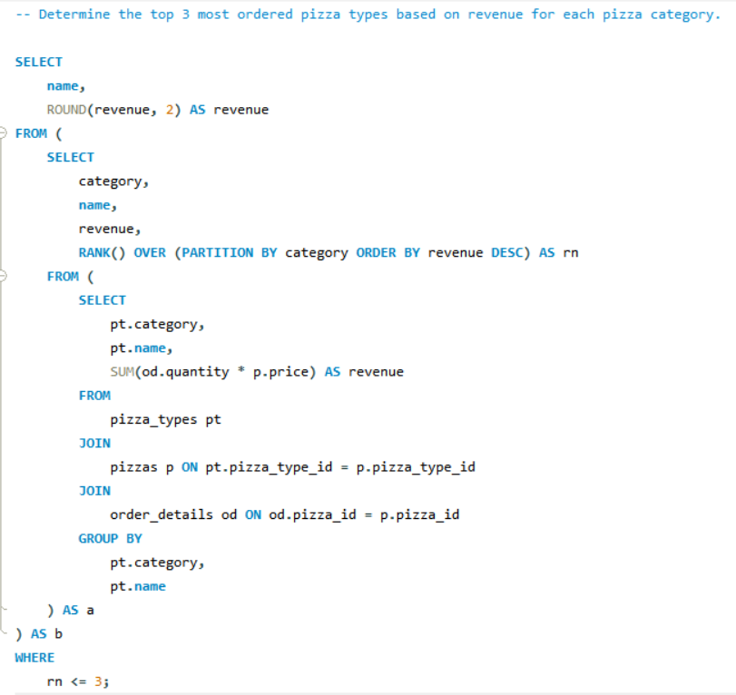
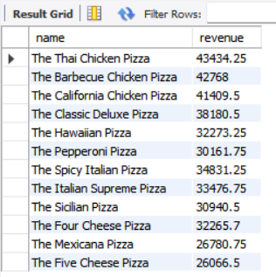
Determine the top 3 most ordered pizza types based on revenue for each pizza category.

Slide 16
Strategies for growth
Key Strategies :
Identify top-performing products to boost marketing focus.
Determine customer preferences by time and size.
Leverage high-revenue pizza types for bundled offers.
Align kitchen operations with peak ordering hours.

Slide 17
Marketing strategies
Insights:
Category-Wise Quantity Analysis helps decide what type of pizzas to scale up.
Hourly Distribution of Orders guides expansion of delivery hours or promotions.
Category Distribution informs inventory and staffing.
Opportunities:
Promote popular categories during high order hours.
Expand offerings in underperforming categories.

Slide 18
Innovative solutions
Solutions :
Focus on high-revenue items for premium promotions.
Reconsider stock for low-contribution pizzas.

Slide 19
Sales Targets
Key Metric :
Average Pizzas Ordered Per Day : 138
Use Case : Set weekly or monthly pizza sales targets based on the average daily sales to monitor store performance.

Slide 20
Future initiatives
Cumulative Revenue Over Time
Top 3 Revenue Pizzas by Category :
The Thai Chicken Pizza The Barbecue Chicken Pizza
The California Chicken Pizza
Future Plans:
Dynamic pricing based on trends.
Automated dashboards for daily sales monitoring.
Geo-based performance tracking with branch comparison.

Slide 21
Thank you
Connect With Me :
Github : https://github.com/sanskarchoudhari-1
Email : sanskarchoudhari3@gmail.com
Linkedin : www.linkedin.com/in/sanskar-choudhari-720729207

